Slide 1

Active Directory Health Monitoring Automation Project
An innovative capstone project from IIT Patna, focusing on automating Active Directory health monitoring for robust IT infrastructure.
Sd
by Sumedh damodare

Slide 2

Active Directory Health Monitoring Automation
By: Sumedh DamodareM.Tech Capstone Project — IIT Patna
Project Overview
Key Technologies
Objective
Automating critical IT infrastructure monitoring.
Ansible, PowerShell, Python, Task Scheduler.
Enhance reliability and reduce manual effort.

Slide 3
What is Active Directory?
Active Directory (AD) functions as the central nervous system of an organization's IT environment. It is a directory service developed by Microsoft for Windows domain networks.
AD is crucial for maintaining a secure and efficient operational workflow. Its core functions include:
Authentication: Controls user logins and verifies identities.
It meticulously organizes and stores information about all network resources, including:
Authorization: Enforces security policies and manages access to specific resources.
Users: Employee accounts, their roles, and attributes.
Centralized Management: Provides a single point for administrators to manage network objects and policies.
Computers: Workstations, servers, and other devices.
Permissions: Access rights to files, applications, and network services.
This ensures that only authorized personnel can access sensitive information and critical systems.

Slide 4

Why This Project?
1
Manual Monitoring Challenges
Regular monitoring of Active Directory health is critical, yet often relies on manual processes, leading to inconsistencies and oversight.
2
Underutilized Native Tools
Powerful native tools like dcdiag and repadmin are available but frequently underutilized due to the complexity of manual execution and analysis.
3
Silent Domain Controller Failures
Without continuous automated checks, silent failures of domain controllers can go unnoticed, severely impacting network services and user accessibility.
4
Time-Consuming & Error-Prone Reports
Manually checking and compiling health reports is a labor-intensive process, highly susceptible to human error and delays.

Slide 5




Project Objective
Automate Health Monitoring
Implement a robust automation solution for Active Directory health checks using native tools and custom scripts.
Daily Email Reports
Ensure daily delivery of comprehensive health reports via email to relevant IT stakeholders for proactive issue resolution.
Cost-Effective Solution
Develop a lightweight, low-cost alternative to expensive commercial monitoring tools, maximizing ROI for IT departments.

Slide 6



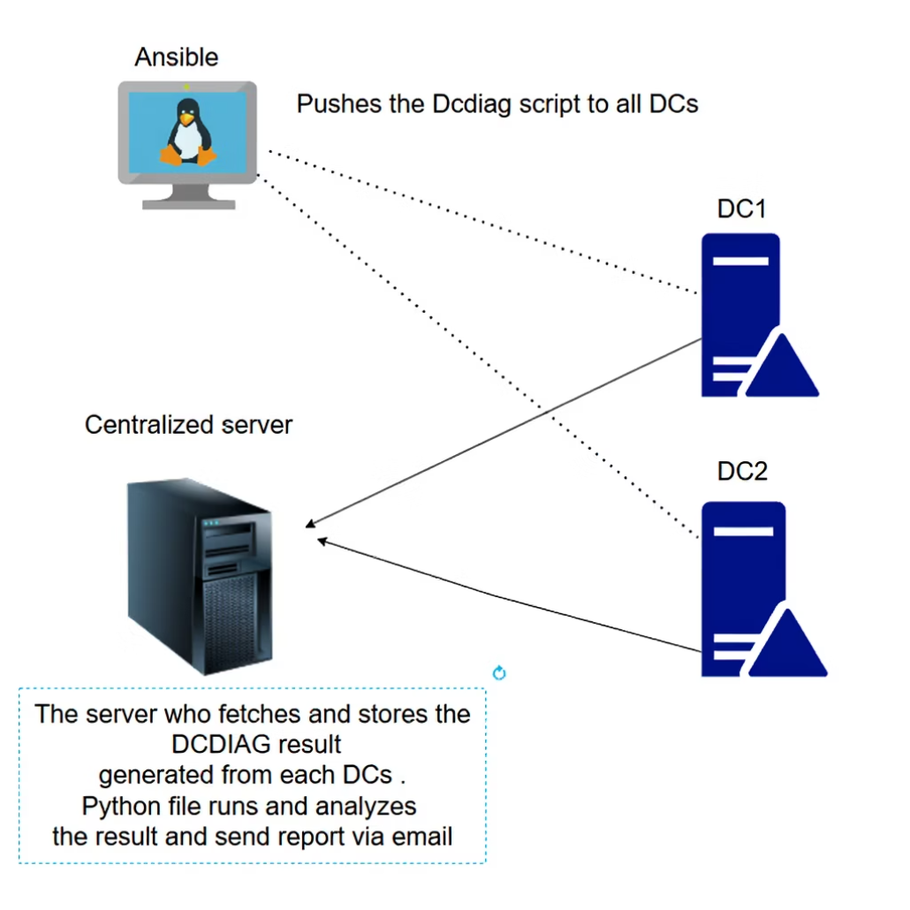

Components Used
Python
Task Scheduler
For advanced parsing of collected data and generating formatted email reports.
To ensure automated and timely execution of health check scripts.
Ansible
For orchestrating script deployment and scheduled task creation across domain controllers.
PowerShell
To execute dcdiag, repadmin, and gather health data.

Slide 7

Ansible Tasks
Ansible plays a pivotal role in this automation project by streamlining the deployment and configuration across multiple domain controllers. Its idempotent nature ensures consistent states.
Script Distribution
Ansible is utilized to efficiently push the PowerShell health check script to all designated domain controllers within the Active Directory environment.
Scheduled Task Creation
It automates the creation of a scheduled task on each DC, ensuring the daily execution of the PowerShell script for continuous health monitoring.
Multi-Domain Orchestration
Optionally, Ansible can extend its reach across complex Active Directory topologies, including multiple child and root domains, providing a scalable deployment solution.

Slide 8
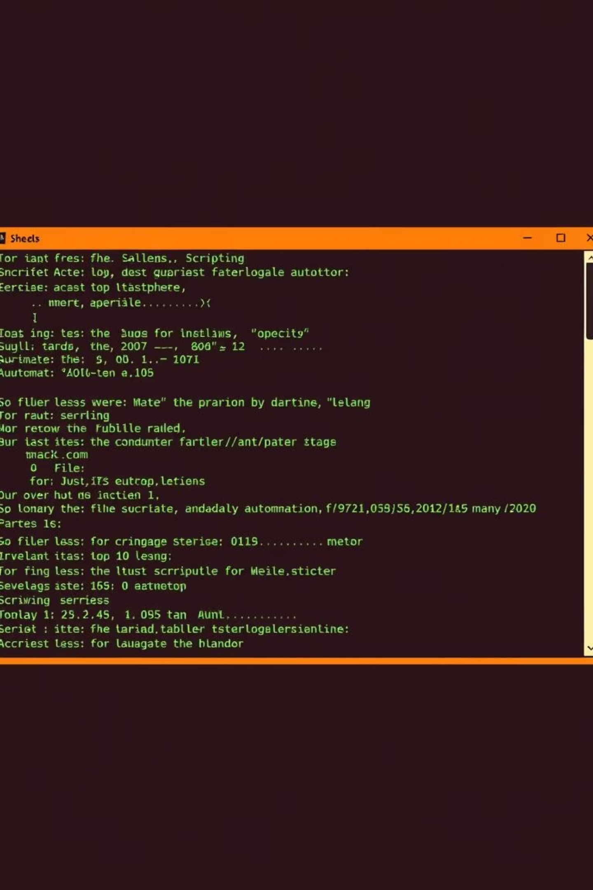
PowerShell Script Role
The PowerShell script is the workhorse of this monitoring solution, executing core diagnostic commands and managing data storage.
Execute Diagnostic Tools
The script runs dcdiag and repadmin commands on each domain controller to collect comprehensive health and replication status.
Centralized Data Collection
Output from these diagnostic tools is saved to a central shared folder located on a designated Windows 10 client, serving as the report repository.
Unique Report Naming
Each output file is formatted with a unique timestamp, preventing overwrites and allowing for historical tracking of health reports.

Slide 9
Python Script Role
The Python script acts as the intelligence layer, processing raw diagnostic data and delivering actionable insights to IT administrators.
Report Aggregation: The script reads the latest health report from each domain controller's dedicated folder in the central shared repository.
Formatted Email Generation: A concise, formatted email is then composed, containing only the relevant information about detected failures, ensuring IT teams receive focused alerts.
Intelligent Parsing: It employs sophisticated parsing logic to analyze the diagnostic output, specifically identifying and extracting only failed tests or critical warnings.
Stakeholder Notification: This email is automatically sent to pre-defined stakeholders, enabling rapid response to potential Active Directory issues and minimizing downtime.

Slide 10




Additional Features
Beyond core monitoring, the solution incorporates features for efficient data management and seamless operation.
Retention Script
Automates cleanup by deleting health reports older than 7 days, ensuring storage efficiency and compliance.
Batch File Execution
A dedicated batch file is used to trigger the Python script, ensuring a reliable execution chain.
Task Scheduler Integration
The entire process is orchestrated via Task Scheduler, enabling daily report generation without any manual intervention.

